Slide 1

Topic: Categorical and Numerical Data EQ: How do you compare categorical and numerical data?
Year 11 Essentials

Slide 2
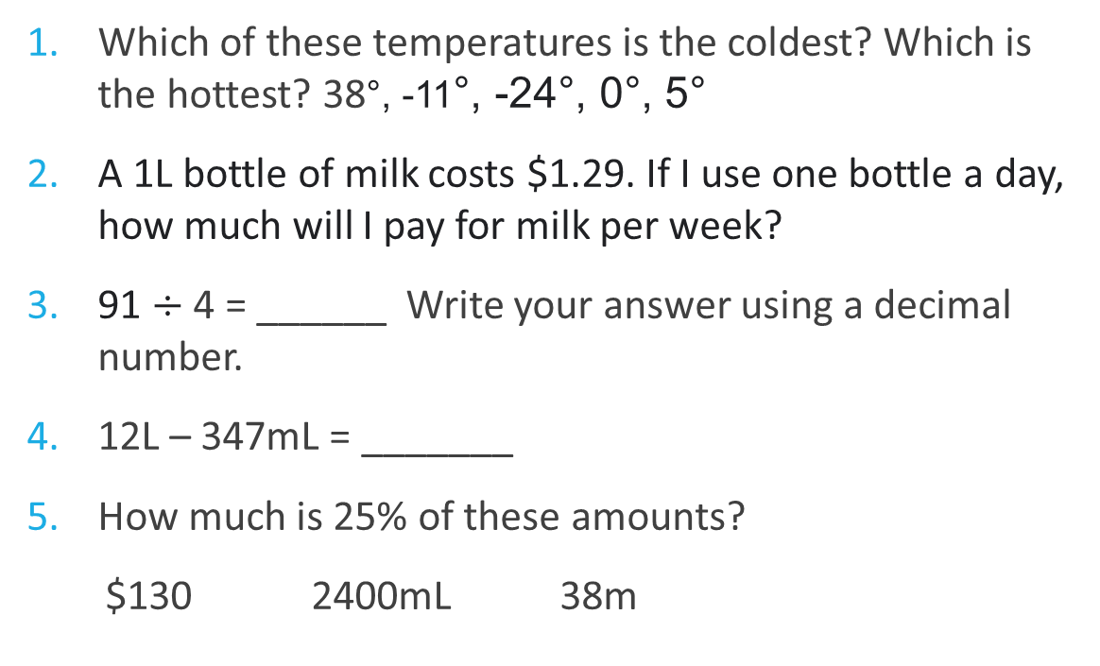
First 5
Topic: Categorical and Numerical Data EQ: How do you compare categorical and numerical data?
Which of these temperatures is the coldest? Which is the hottest? 38°, -11°, -24°, 0°, 5°
A 1L bottle of milk costs $1.29. If I use one bottle a day, how much will I pay for milk per week?
91 $÷$ 4 = ______ Write your answer using a decimal number.
12L – 347mL = _______
How much is 25% of these amounts?
$130 2400mL 38m
1. coldest: -24 °, hottest: 38 °
2. $9.03 0r $9.05 cash
3. 22.75
4. 11 653 mL
5. $32.50, 600mL, 9.5m

Slide 3
Topic: Categorical and Numerical Data EQ: How do you compare categorical and numerical data?
What is a back-to-back stem and leaf plot?
What is an example of a stem and leaf plot?
When we collect, analyse or display data, it is good to be able to group and organize data. Sometimes, data is best to be grouped in categoried and other time grouped numerically.
Age of shoppers entering office supplies store
Females Stem Males
8 7 5 5 2 2 6 8
6 4 4 3 3 0 1 7 8 9
1 4 1 4 5

Slide 4
Topic: Categorical and Numerical Data EQ: How do you compare categorical and numerical data?
Think - Pair - Share (Page 98)
Consider each of the topics below and decide whether the data would be categorical, numerical or a mix of both. Discuss what types of graphs or tables would be appropriate for each data set.
Age of parents at the birth of their first child
Meals consumed by diners at a restaurant
Health content of meals consumed by diners at a restaurant
Fitness of members of a sporting club

Slide 5
TASK: Investigate
Page 98
Topic: Categorical and Numerical Data
EQ: How do you compare categorical and numerical data?
You need to gather data on the following aspects of fitness. Consider each aspect in turn and brainstorm what aspects you could gather data on.
Would this data categorical or numerical?
What sorts of displays do you think would be appropriate to show the initial data?
Consider the following:
Flexibility (for example, stretching towards toes with knees straight)
Strength (for example, lifting weight with legs or arms)
Endurance (for example, time holding a standing squat or plank)
Cardiovascular fitness (for example, heart rate after set exercise then checked again at given intervals after completing the exercise.

